Slide 1
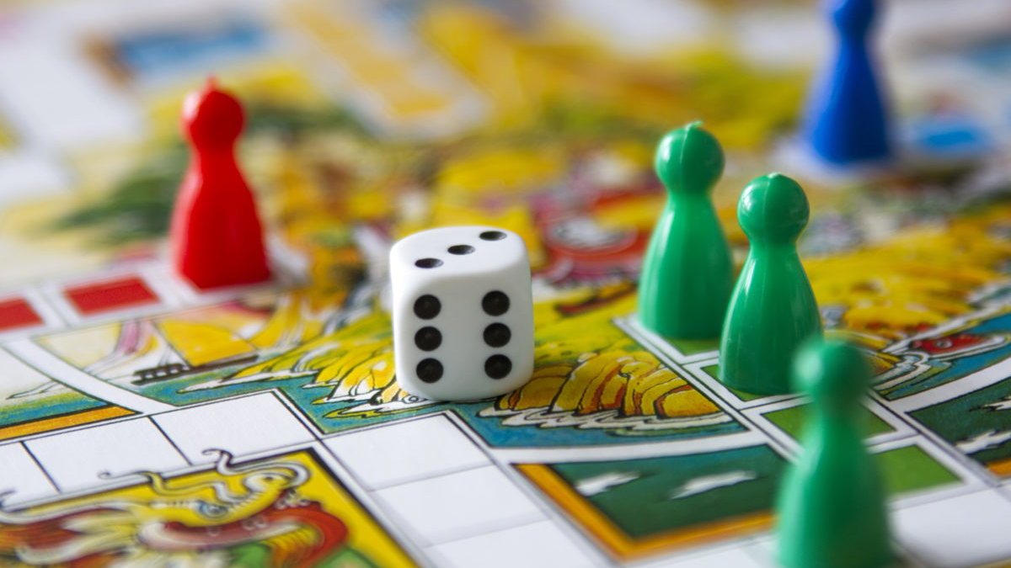
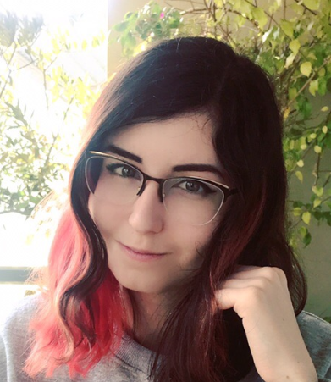
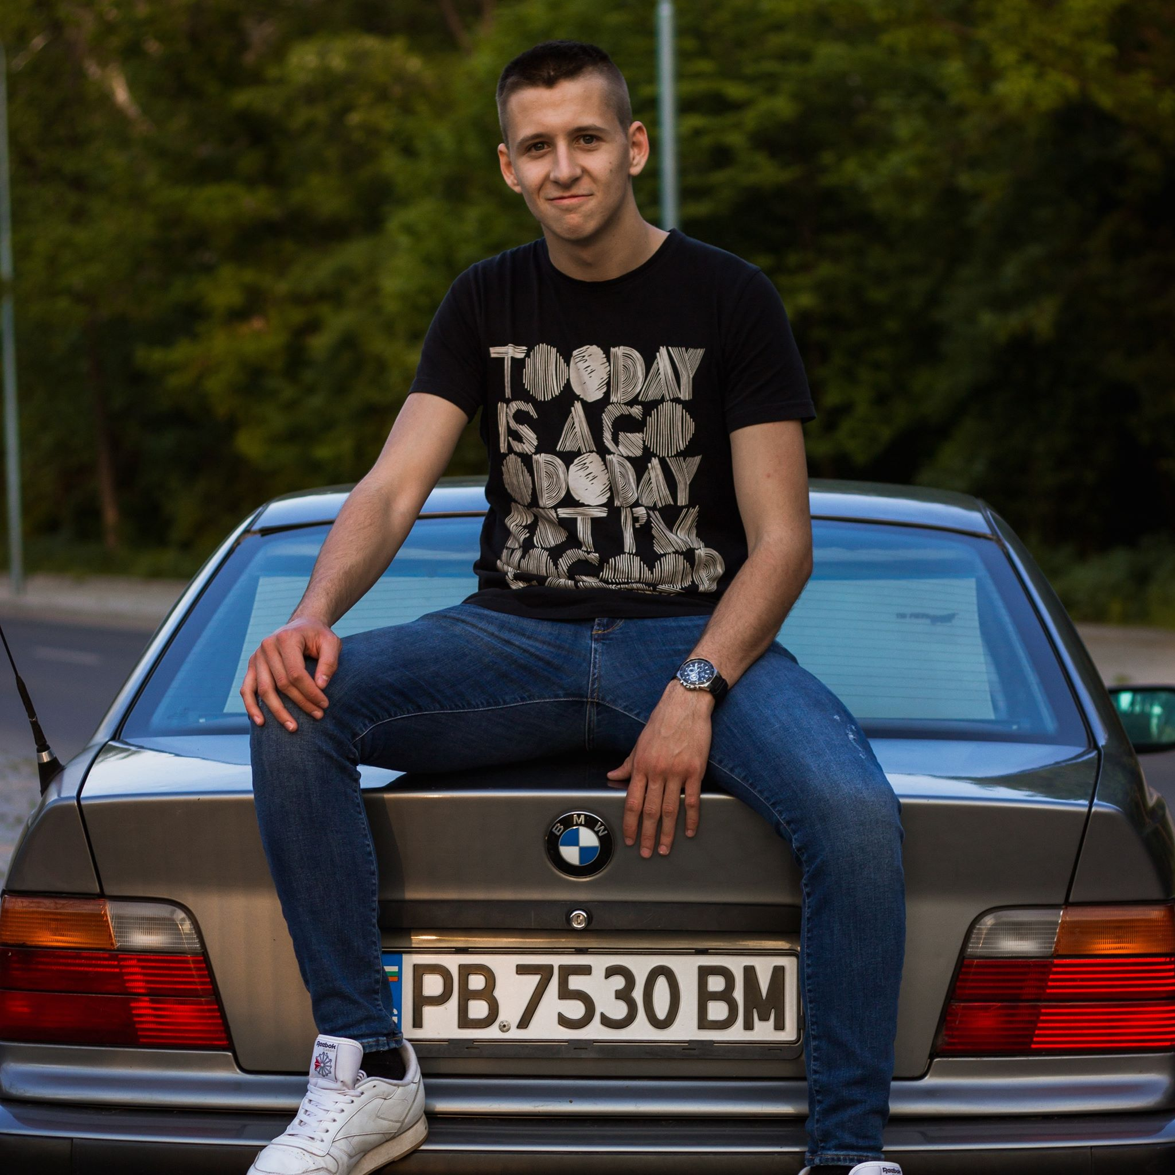
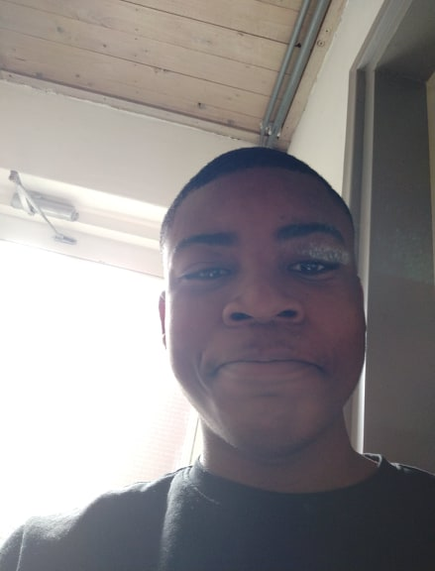
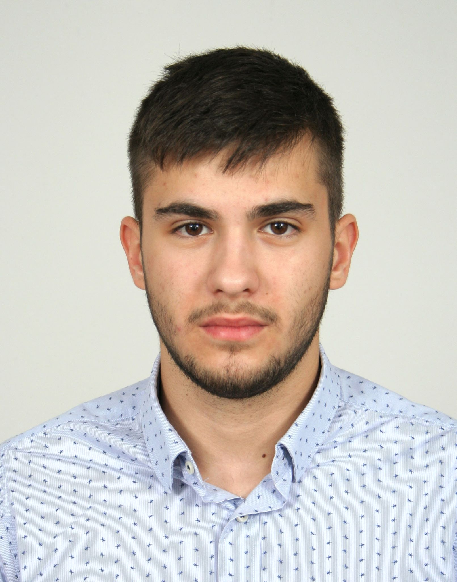
Team introduction
Maria Khovanskaya
e-b21
Dimitr Ivanov
e-s26
“Mad projects”
David Hooi
e-t21
Martin Grigorov
e-s22

Slide 2
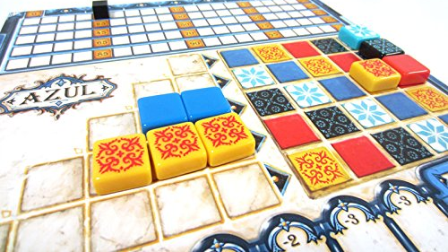
Introduction about the project
Steps:
Determine processes
Efficient automatization
Development
Testing
Website and applications for event management:
Tickets management
Purchases management
Rent management
Transactions management
Key values:
Usability
Scalability
Performance
Stability
Notes:
Usability – everything is comfortable and easy for user
Scalability – it’s easy to add new features or resize the project to bigger events or more events
Performance – everything runs fast and smooth

Slide 3
Website
Event pack
Website
Application
Used by visitors to:
Create an account (login/logout)
Purchase ticket (+ buy merch)
Top-up balance
Reserve a camp spot
Leave and read reviews
Contact event/developers
Used by employees to:
Check visitors in and out of event
Sell food and beverages at shops
Loan and collect items at loan stands
Check in to camping spots
See overview of event
Manage employees

Slide 4
Website
Why our website
Intuitively understandable interface
Most-used data stored in session (better performance)
User’s data input is always checked
Visitor receives QR ticket
Visitor can communicate with event via contact form
User can only access relevant pages
Fully tested
Based on existing event-management practices

Slide 5
Why our application
One application used by all employees
Fully tested to be as efficient and user-friendly as possible
Intuitively understandable interface uses minimal input
Visitor is given a RFID a bracelet
Very clear error prevention and handling
Very expandable (MVVM structure)
Designed to service many visitors quickly

Slide 6
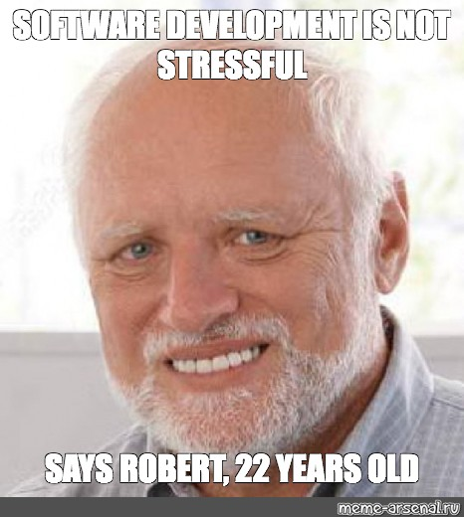
Personal impression: David
Unique and Educating experience
Stressful at times
Happy with result
Happy with amazing team

Slide 7
Personal impression: Martin
Overall great experience
The project felt like working with real clients
Satisfied with the finished product
More than satisfied with our team and time management

Slide 8
Personal impression: Dimitar
Perfect first try in ICT projects
Good team = Good result
It was like having a real job
Looking positive for future projects

Slide 9
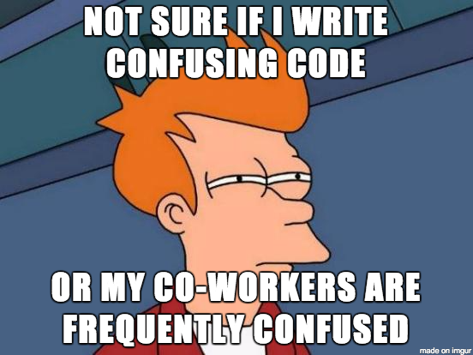
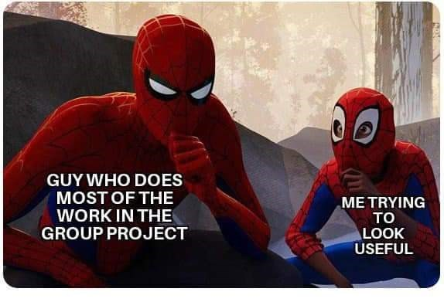
Personal impression: Maria
Interesting experience
A big project from meeting with client to production
Happy with result
Happy with awesome team

